Slide 1
Creating Offline Solutions with SharePoint Workspace 2010
Notes:
Working with SharePoint offline is a powerful feature that is made available with the use of SharePoint Workspace 2010 (formerly called Groove). Using Workspace 2010, site users can continue to contribute and collaborate easily while they are not connected to the site online. Once back online, the changes automatically synchronize back to SharePoint online. You will learn how to setup a SharePoint Workspace to take advantage of this powerful feature.

Slide 2
Agenda
Overview of SharePoint Workspace
Features and Functionality
Architecture
Permissions

Slide 3
What Is It?
Microsoft Office 2010 client application that syncs with SharePoint
Gives users fast, anytime, anywhere access to SharePoint content
SharePoint
Workspace 2010
SharePoint
2010
Notes:
SharePoint Workspace 2010 is a Microsoft’s rich client application for SharePoint Team Sites. It’s part of Office Professional Plus suite.
SharePoint Workspace gives users fast, anytime and uninterrupted access to their SharePoint content. Local copy of site’s content – lists and libraries – are readily available in the workspace. The application is installed on a workstation and is great for mobile workers working at a customer site, airport or at a conference getting all the updates.
Even the users who don’t travel will have fast access to their content plus they’ll be immune from maintenance periods when their sites are down since will they still have access to their offline content.

Slide 4


What Does It Sync?
Collaborative content from SharePoint 2010
Team sites and My Sites
Document libraries, lists, external lists
SharePoint
Workspace 2010
SharePoint
2010
Notes:
SharePoint Workspace syncs collaborative content – documents, tasks, announcements, links, custom lists etc. It does not sync the text information listed on a page on the site or web parts.
Aside from Team Sites, SP Workspace also synchronizes a My Site.
Note: Site Pages library and Calendar list are not supported in Workspace. They show up in the workspace, but just navigate you to the data through the browser.

Slide 5
Agenda
Overview of SharePoint Workspace
Features and Functionality
Architecture
Permissions

Slide 6
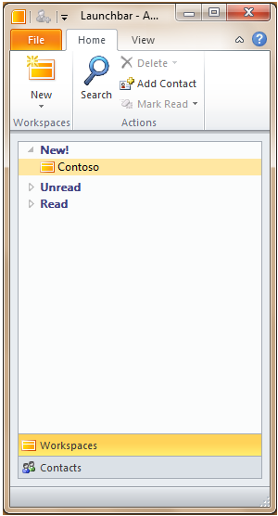
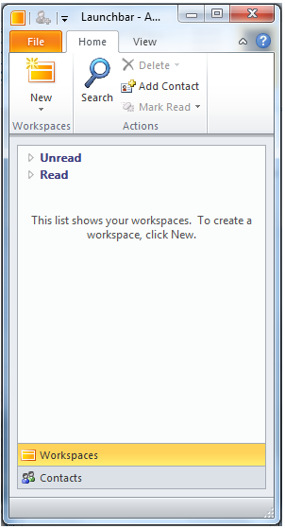
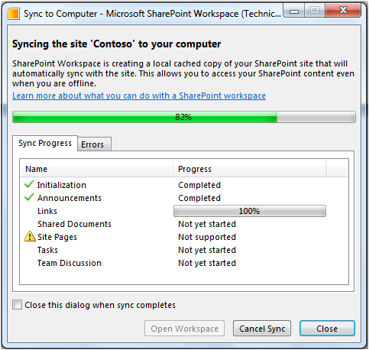

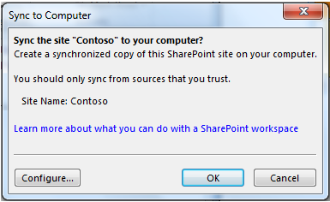

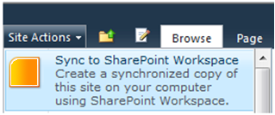
Easy To Use
Notes:
Workspace is never created empty. It always has a connection to a site on the server. New workspace is created using the Workspace directly or using the ‘Sync to SharePoint Workspace’ button in the browser.
When making a connection, the workspace can be configured to exclude certain lists or libraries. Sometimes that’s a good idea to save on bandwidth and disk space on the local machine.
To sync lists using SP Workspace,start from the site in the browser or start from the workspace LaunchBar and create the workspace.

Slide 7
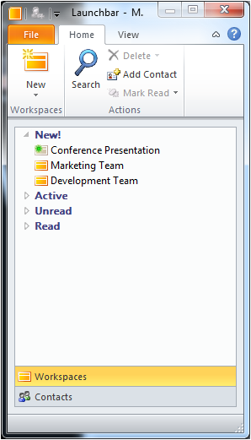
Launchbar
Starting point for the SharePoint Workspace
Create Workspace / Search for information in existing workspace
Notes:
In the SP Workspace launch, you can see your sites that you care about and need access to. Launchbar is like a bookmark showing you the sites that you are interested in.
Search – SP Workspace lets you search cached offline data stored on the machine.

Slide 8
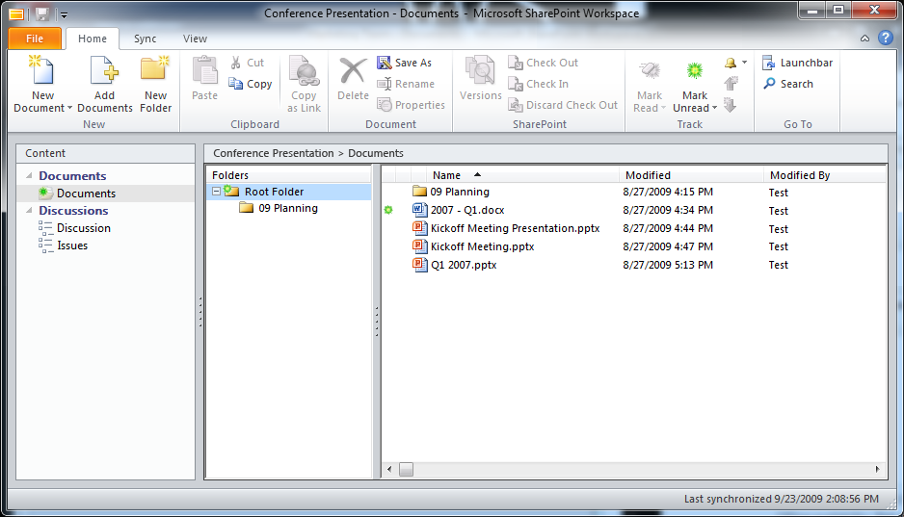
Workspace Window
Lists
Unread
Fluent
Notes:
Like the Quick Launch in the browser, the left navigation shows list of Lists and Libraries.
Fluent interface using the ribbon – no new learning curve. Very similar to the SharePoint user interface in the browser.
The unread green icon can be drilled to see exactly which folder and then which document(s) are unread.
The UI forms are customizable using InfoPath. The environment respects SharePoint view settings (filter/sort/group). Provides error/conflict resolution for all updates to the content.

Slide 9
DEMO
SharePoint Workspace Overview

Slide 10
Agenda
Overview of SharePoint Workspace
Features and Functionality
Architecture
Permissions

Slide 11
SharePoint Workspace Architecture
SharePoint Workspace UI
Storage
Office Data Connections
SharePoint Workspace
BCS
SharePoint 2010
External System
Notes:
The storage mechanism – 3 stores:
Office document cache – all documents in the workspace are stored here. Uses file sync via SOAP over HTTP protocol. Efficient handling of file transfer. Ability to co-author. Fastest sync available from Microsoft.
SharePointWorkspace – relational database specific to workspace uses list items, folders – basically all items that are not documents.
Business Connectivity Services – External Lists. Schema is synced with SharePoint server but content is synced directly with line of business apps.

Slide 12
Sync Model Download vs. Upload
SharePoint
2010
List of lists
Schema
Views
Content
Content
SharePoint
Workspace 2010
Notes:
After first sync, only content is synced incrementally. No lists or list views can be created from workspace. Use the browser for this.

Slide 13


Sync Frequency
Automatic sync
Adaptive sync
Notes:
When SP Workspace is opened in the UI – syncs every 10 minutes.
When SP Workspace is closed in the UI – syncs every 20 minutes.
Server also responds to its health. If it’s not doing good, sync backs off and does syncs less frequently.
Adaptive sync – people care about their edits and want current data. When user navigates into a list, workspace asks SharePoint if this list content is fresh, if not, update it.

Slide 14
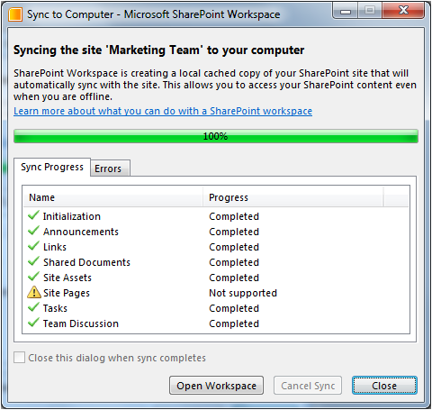


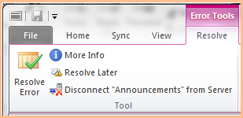
Sync UI
Progress dialog
Status Bar
Error States
Notes:
Limit of 30,000 items in a list – stops syncing it after that. User is prompted about that with a visual indication.
Error tabs shows any errors that exist in syncing the data and guides you to resolve them.

Slide 15
Agenda
Overview of SharePoint Workspace
Features and Functionality
Architecture
Permissions

Slide 16
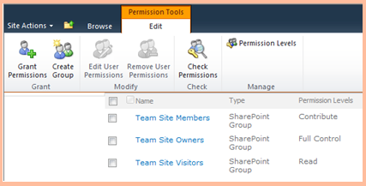
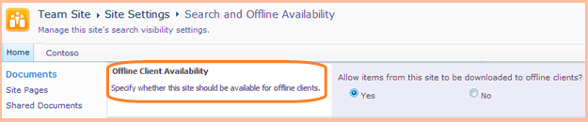
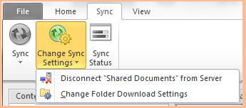
Control
Permissions
Site and list settings
User
Notes:
Permissions from the site itself are respected within SharePoint Workspace. If a user is a contributor of a site, she will only have contribute permissions.
SP Workspace availability for a site can be turned off by a Site Admin.
User can tweak what’s synced and what’s not.

Slide 17
DEMO
SharePoint Workspace Permissions

Slide 18
Offline External List Storage in Workspace
Download to SharePoint Workspace as
Lists
Word doc libraries with external data columns
External Lists:
Only the schema is synchronized
No data is cached offline
Notes:
External Lists information is also synchronized with Workspace so your line of business application data is now visible and available to you offline.
Relies on external content types (ECT) created through SharePoint Designer or programmatically. Data in external list is stored in external system, not cached in SharePoint. Just the list schema is synced.
External Data Columns – add data from ECT to a standard SP list. These columns also show up in the Workspace then.

Slide 19
DEMO
External Lists in SharePoint Workspace

Slide 20
Summary
Overview of SharePoint Workspace
Features and Functionality
Architecture
Permissions

